Slide 1
Statistics for Linguists
2023-11-22
Power, effect size and linear models

Slide 2
From last class
sample variance
t statistic
(z-statistic)
p-value
interval probabilities

Slide 3
For this class
Power, Type I and II errors
Models
Linear models
ANOVA

Slide 4
P-value
What is a p-value?
How is it calculated?
Why is it calculated this way?

Slide 5
P-value
What is a p-value?
Its an interval probability in relation to a hypothetical distribution that imagines you performed an experiment forever (or gathered data forever).
How is it calculated?
You need a t statistic (z statistic) and a probability distribution (a t distribution if you are doing a t test) -imaginary hypothetical distribution of values we assume if there was no difference between your groups or no relationship between your variables.
Why is it calculated this way?
There’s a complicated historical reason for this - but basically you are calculating the probability of your data given a null hypothesis.
You are not doing the more intuitive thing of calculating the probability of your hypothesis given your data.

Slide 6
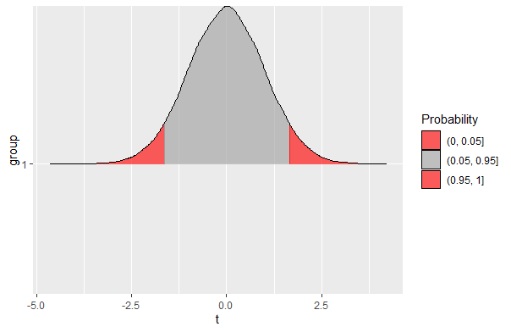
P-value
Imagine running the test for t over and over again – you would get a distribution of t statistics
The p-value is a calculation of how likely that t statistic is according to that distribution (called the t distribution)

Slide 7
P values
A p-value is the probability of receiving a specific statistic (T statistic, F statistic, R-squared) in relation to a hypothetical sampling distribution.
You can calculate the p-value from the T/F etc. statistic.
The decision to use a given alpha level (e.g. 0.05) is arbitrary.
Often, the decision to use one statistic depends on properties of your data (are they continuous, how large is your sample size, are the groups of equal size) – sometimes its just arbitrary though.

Slide 8
P values
Type 1 error: you reject the null hypothesis when its true (false positive).
Type 2 error: you accept the null hypothesis when its false (false negative).

Slide 9
Type II Error & Power
Failing to reject the null hypothesis when its false
E.g. you get a p-value below significance level, and you think your study doesn’t support the alternative hypothesis
Power of a test: the probability of not making a Type II Error
(there’s a thing called Power analysis, which asks how larger your sample has to be to detect a particular effect)

Slide 10
Type II Error & Power
What affects Power?
Significance/alpha level (lower level = less power)
Sample size (larger sample = more power)
Sample size (larger sample = more power)
Variability (less variability = more power)
Magnitude of the effect (larger magnitude = more power)

Slide 11
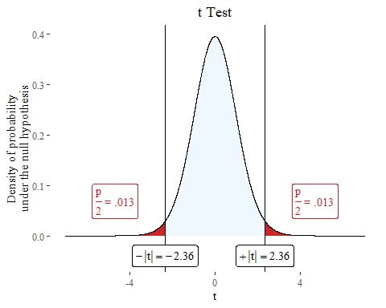
set.seed(1234) n <- 30 vowel.durations <- rnorm(n, mean = 80, sd=10) h1 <- c("strong","weak") h1 <- sample(h1, n, replace=TRUE, prob=c(0.5, 0.5)) h2 <- c("strong","weak") h2 <- sample(h2, n, replace=TRUE, prob=c(0.5, 0.5)) h3 <- c("strong","weak") h3 <- sample(h3, n, replace=TRUE, prob=c(0.5, 0.5)) h4 <- c("strong","weak") h4 <- sample(h4, n, replace=TRUE, prob=c(0.5, 0.5)) h5 <- c("strong","weak") h5 <- sample(h5, n, replace=TRUE, prob=c(0.5, 0.5)) h6 <- c("strong","weak") h6 <- sample(h6, n, replace=TRUE, prob=c(0.5, 0.5)) df <- data.frame(vowel.durations, h1,h2,h3,h4,h5,h6)
plotttest(t.test(vowel.durations~h4, data=df))

Slide 12
Type I Error & Sensitivity
Type I Error: Rejection of a true null hypothesis
Sensitivity: The probability of not making a Type I Error

Slide 13
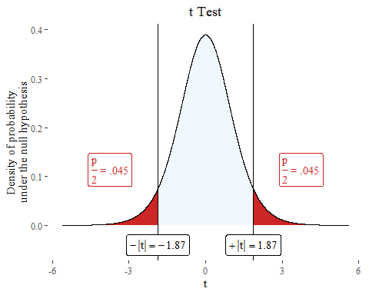
set.seed(123) n <- 6 strong.vowels <- rnorm(n, mean = 85, sd = 10) weak.vowels <- rnorm(n, mean = 80, sd = 10) strong <- rep("yes", times =n, length.out=n) weak <- rep("no", times =n, length.out=n) vowel.durations <- list.append(strong.vowels, weak.vowels) prominence <- list.append(strong, weak) t <- (mean(strong.vowels) - mean(weak.vowels)) / (sqrt((var(strong.vowels)/n) + (var(weak.vowels)/n))) t
## [1] 1.873338
plotttest(t.test(vowel.durations~prominence), tails = "one")

Slide 14
Trying and trying again or p-hacking
If we have enough variables we will eventually find a significant correlation.
If we sample more from the population we will eventually get a significant value.
If we do multiple comparisons we should adjust the p value downwards
In principle (although hard to follow in practice), use of p values should involve a stopping rule stated prior to the study, because if you gather enough data you will always eventually get a significant result.

Slide 15
What to report
When you report statistical tests, you wouldn’t just report the p-value, rather you report the following:
p-value
test statistic
confidence intervals (more on this later)
effect size

Slide 16
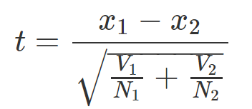
A note on effect sizes
We are often more interested in ‘effect sizes’: how large the difference is – note that the p-value conflates the effect size with the sample size
There are other measures of effect size we’ll get to later.
Effect size

Slide 17

Model
A “model” is a simplified version of some aspect of the world
They are cognitive tools for understanding
Collins & Pinch analogize models with ‘Golems’ from Jewish folklore
The idea: a useful tool to be called forth for a specific purpose, but that can also be ‘dangerous’ (lead you astray)
https://upload.wikimedia.org/wikipedia/commons/9/9f/Prague-golem-reproduction.jpg

Slide 18
Model
Models are stupid
“Models are, by and large, stupid. My point of contention is with the conclusion that stupid models are not useful. Quite the contrary. Stupid models are extremely useful. They are useful because humans are boundedly rational and because language is imprecise. It is often only by formalizing a complex system that we can make progress in understanding it. Formal models should be a necessary component of the behavioral scientist’s toolkit. Models are stupid, and we need more of them.”
Smaldino, Paul E. 2017. Models are stupid and we need more of them. Computational Social Psychology. Valalcher, R. (ed.)
https://upload.wikimedia.org/wikipedia/commons/9/9f/Prague-golem-reproduction.jpg

Slide 19
Dependent vs. independent variable
What makes a model ‘inferential’
Dependent variable: The variable you are predicting (interesting in explaining)
Independent/predictor variable: The variable that you use to make predictions

Slide 20
Inferential statistics vs. exploratory data analysis
If you don’t have a dependent vs. independent variable distinction you aren’t doing inferential stats, you are doing exploratory data analysis.
(Some would claim: if you don’t have a distinction between dependent vs. independent variable before you start modelling, you aren’t really doing inferential statistics either)
Nosek et al. 2019 for discussion
Nosek, B. et al. 2019. The pregistration revolution. PNAS 115:11

Slide 21
Types of variables
Types of variables
Continuous: In principle, indefinitely differentiable
coded as ‘double’ or ‘numeric’ in R
Categorical: Discrete categories
Coded as ‘character’ or ‘factor’ in R
Binary: Just 0 or 1 (only two options)
Ranked: Coded in ranked levels

Slide 22
Major ‘basic’ (most used) types of inferential models
Regression: dependent and predictor variables are both continuous
ANOVA: dependent variable is continuous, predictor variable is categorical
Logistic regression: dependent variable is binary, predictor variable is continuous
Chi-squared: Both variables are categorical

Slide 23
Parametric
‘Parametric’ statistical tests make assumptions about the structure of the data
They assume that parameters are normally distributed
They assume variance stays the same across all levels / distribution
homoscedastic
They assume errors are normal
They assume errors are independent from one another

Slide 24
Parametric vs. nonparametric tests
Nonparametric tests do not make these assumptions, they just ask about monotonic increase of one variable in relation to another
Tau statistic
Pearson’s rho
I find these more useful if you are just looking at correlations for exploratory purposes (e.g. you have a lot of variables and you want to see how well they are associated one by one)

Slide 25
Some notes
A lot of statistics classes teach based on flow charts which tell you which tests you should use, but lots of people bash them for teaching students to apply tests without thinking about what makes sense.
Clayton 2021; McElreath 2023
It often makes sense to use more than one modelling technique to see if they converge on the same result – different models might give you different perspectives on the data
Page 2018
Clayton, Aubrey. 2021. Bernouilli’s fallacy. Columbia University Press
McElreath, Richard. 2023. Statistical Rethinking. Chapman & Hall.
Page, Scott E. 2018. The Model Thinker. Basic Books.

Slide 26
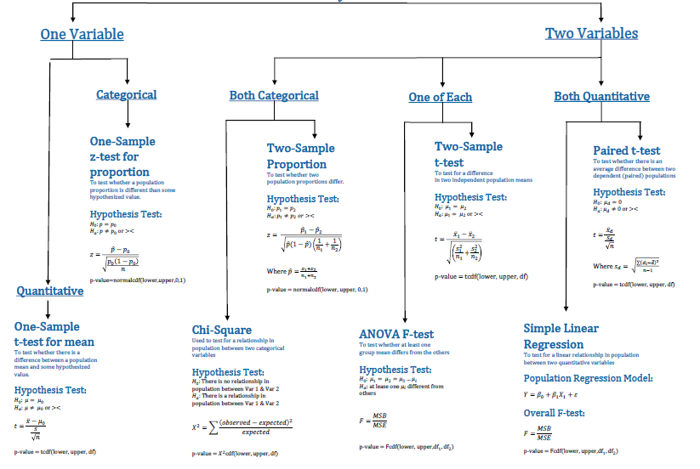

Slide 27
Statistic test flow chart
There’s a cool interactive one online
https://www.statsflowchart.co.uk/

Slide 28
What is regression?
T-test is used when the dependent variable is continuous and the independent variable is categorical.
Chi-squared test can be used when all of your variables are categorical.
Regression analysis can be used when the dependent and independent variables are continuous.
(Logistic) regression analysis (next week?) is used when the dependent variable is binary or ordinal and the independent variable is continuous.

Slide 29
Regression analyses in linguistics
Morphosyntax: Relationship between phonological complexity and morphological complexity. (Easterday et al. 2021)
Phonology: The shape and direction of a pitch contour over time.
Language acquisition: Age against vocabulary acquisition (or any measure of language proficiency)
Psycholinguistics: Reaction time against frequency of the word.

Slide 30
Regression analysis
Model choice: When you do a regression analysis you have to decide on what the relationship should be.
What are the different types of relationships two continuous variables can have with one another?

Slide 31
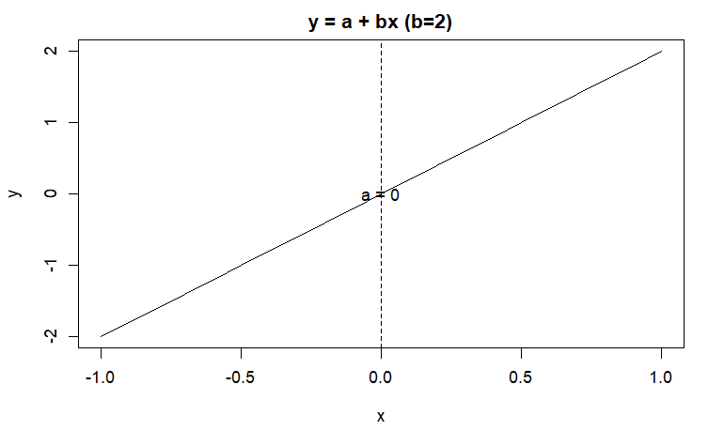
Simple linear model
a is the intercept
b is the coefficient
Y is the dependent variable
X is the independent variable

Slide 32
Exponential function
Will it still be a straight line if it looks like this?
$$y=a+bx^{2}$$

Slide 33
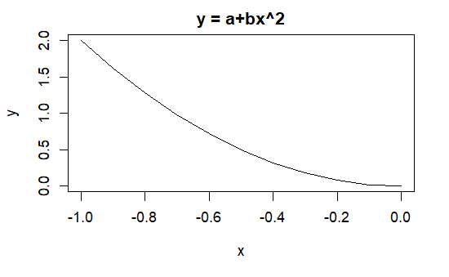
Exponential curve
$$y=a+bx^{2}$$

Slide 34
And this?
$$y=a+bx^{2}$$

Slide 35
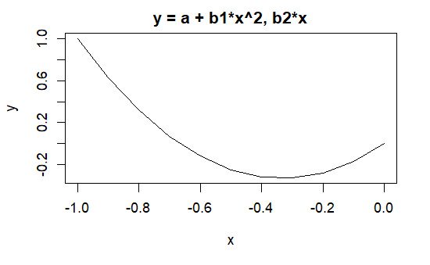
Parabolic curve
$$y=a+b_{1}x^{2}+b_{2}x$$

Slide 36
Model choice
Part of “model choice” is what type of relationship you think x and y display with one another.
Note that the interpretation of the coefficient b / β could be very different depending on the type of model you have.

Slide 37
Calculate ‘b’
To understand the values of a linear model, we need to understand first the meaning of b.

Slide 38
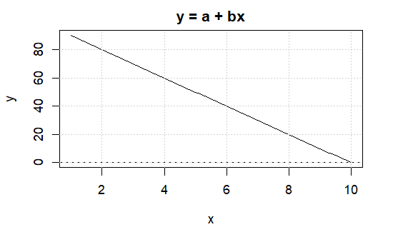
Calculate ‘b’

Slide 39

Calculate ‘b’

Slide 40
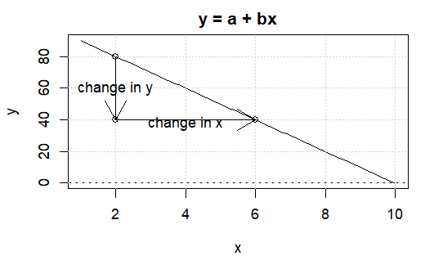
Calculate ‘b’

Slide 41
Word length and reaction times
Download ldt.csv, it is from Rling(), which can be downloaded from Levhsina’s github website

Slide 42
Word length and reaction times
## Length Freq Mean_RT ## Min. : 3.00 Min. : 0.0 Min. : 564.2 ## 1st Qu.: 6.00 1st Qu.: 53.5 1st Qu.: 713.1 ## Median : 8.00 Median : 310.5 Median : 784.9 ## Mean : 8.23 Mean : 3350.3 Mean : 808.3 ## 3rd Qu.:10.00 3rd Qu.: 2103.2 3rd Qu.: 905.2 ## Max. :15.00 Max. :75075.0 Max. :1458.8

Slide 43
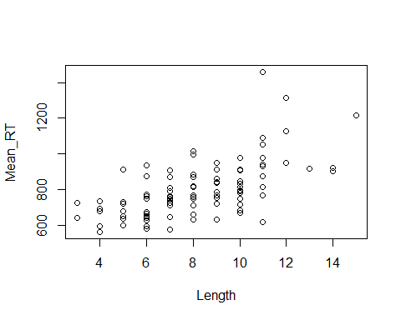

Slide 46
lm(Mean_RT~Length)
## ## Call: ## lm(formula = Mean_RT ~ Length) ## ## Coefficients: ## (Intercept) Length ## 498.44 37.64

Slide 47
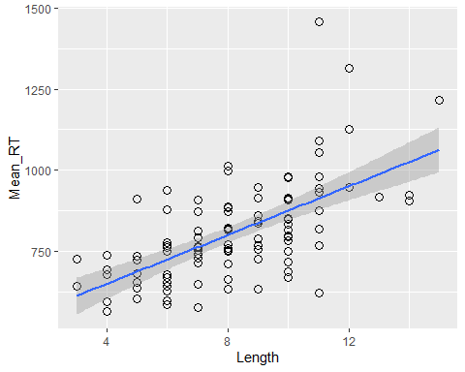
ggplot(ldt, aes(x=Length, y = Mean_RT))+
geom_point(shape=1, size=3)+stat_smooth(method=lm)

Slide 48
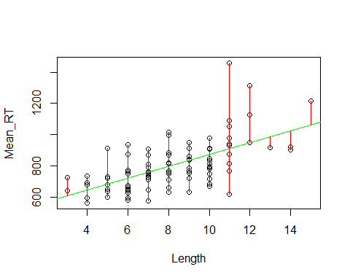
Residuals
A residual is the difference between each data point and the value predicted by the model at the same value of x.
Some residuals are positive and others are negative.

Slide 49
Residuals
$\hat{y}$ refes to the predicted value.
d refers to the residual of a specific data point.
$$d=y−\hat{y}$$
$$d=y−\left(a+bx\right)$$
$$d=y−a+bx$$

Slide 50

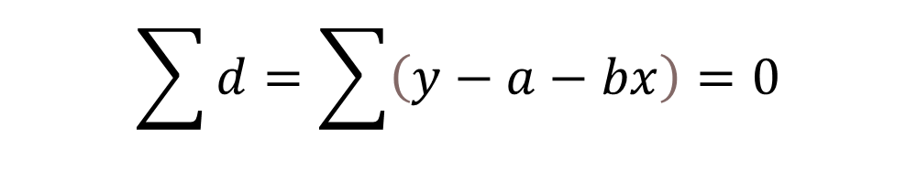
Residuals
A regression calculates a line with interpret and slope that make the sum of the residuals equal to 0 (or as close to 0 as possible)
$$\sum{d}=\sum{\left(y−a−bx\right)}=0$$
$$SSE=\sum{d^{2}}$$

Slide 51
Residuals
Imagine guessing what the slope.
After this we change the value of the slope.
Then we work out the new intercept a = y -bx - d
Then we predict the fitted values of y (reaction time) for the new b.
After this we work out the residuals
Then we calculate the SSE (Sum of squares error)
Then we repeat for values of b until we arrive at the smallest number.

Slide 52
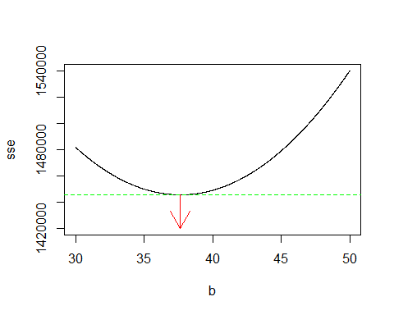
Residuals

Slide 53
Residuals
We get the same result with lm()
lm(Mean_RT~Length)
## ## Call: ## lm(formula = Mean_RT ~ Length) ## ## Coefficients: ## (Intercept) Length ## 498.44 37.64

Slide 54
We stopped here 2023-11-22
The following slides will be included in next weeks lecture

Slide 55
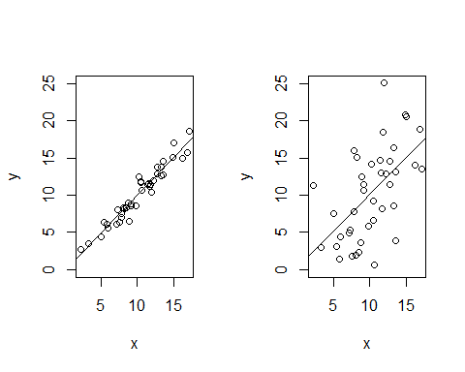
Model fitting
Two regression lines can have the same slope and intercept, but be different with respect to their residuals.

Slide 56
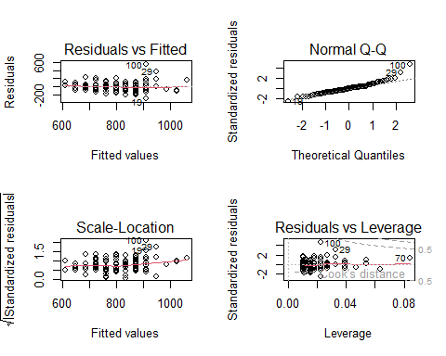
Model checking

Slide 57
ANOVA
What is typically referred to as ANOVA (Analysis of variance) often refers to a type of statistical analysis when all the predictor variables categorical. There is some controversy with respect to whether ANOVA can just be understood as a special case of regression analysis. Compare
Cottingham et al. 2005 ``Regression versus ANOVA” in Frontiers in Ecology and the Environment
Gelman 2006 ``Analysis of variance - why it is more important than ever” in The Annals of Statistics

Slide 58
ANOVA and Regression
ANOVA has the same mathematical structure as regression,but some regard it as conceptually different,
ANOVA can also mean the analysis of data into batches and groups (hierarchical modeling), rather than narrowly as the classical ANOVA test.
For historical reasons the ANOVA is more often used in experimental settings and regression analysis for observational data.
Sometimes classical ANOVA is used, when regression really should be: the research bins the data of the predictor variable into groups to make it categorical (see Stoll & Gries 2009) in Journal of Language Acquisition.

Slide 59
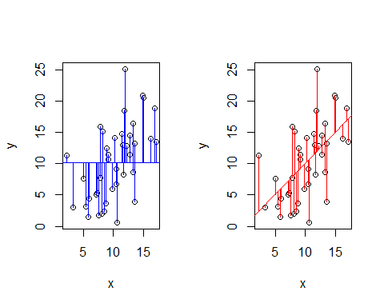
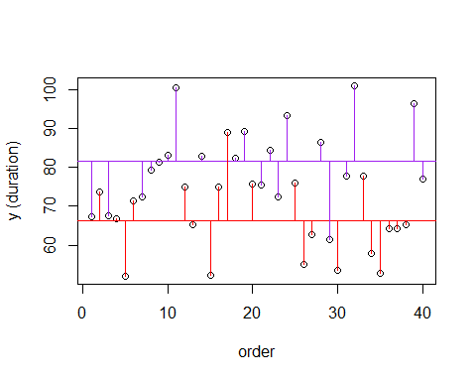
ANOVA and regression

Slide 60
ANOVA
ANOVA belongs to family of statistical techniques known as general linear models.
You are comparing the variances between two groups in relation to the variance of the groups combined.

Slide 61
ANOVA
Simulate some values according to a linear relationship / model.
set.seed(1) school <- sample(c("good", "bad"), size=30, replace=30) school.binary <- ifelse(school == "good", 1, 0) class.grade <- as.integer(rtruncnorm(a=0, b=100, m = 40, sd=15, n =30)) intercept <- 0 b1 <- 15 b2 <- 1 error <- rnorm(m=0, sd=10, n=30) test.score <- intercept + b1*school.binary +b2*class.grade + error test.score <- ifelse(test.score < 0, 0, test.score) test.score <- ifelse(test.score> 100, 100, test.score) test.score <- as.integer(test.score) data <- data.frame(test.score, school, class.grade)

Slide 62
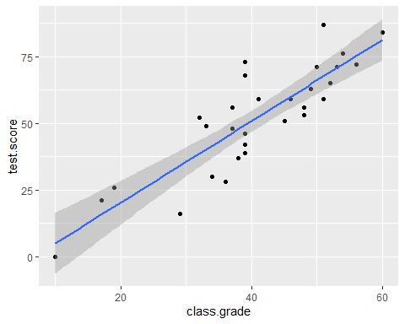
ANOVA
ggplot(data,aes(class.grade, test.score)) + geom_point()+ geom_smooth(method='lm')

Slide 63
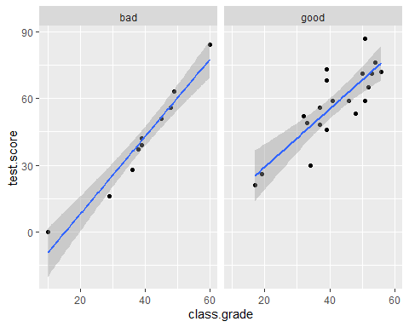
ANOVA
ggplot(data,aes(class.grade, test.score)) + geom_point()+ geom_smooth(method='lm')+ facet_wrap(~school)

Slide 64
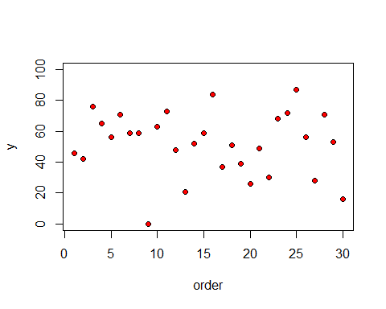
plot(1:30,test.score,ylim=c(0,100),ylab="y",xlab="order",pch=21,bg="red")

Slide 65
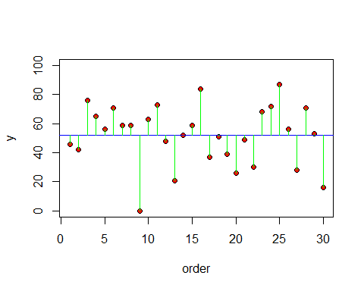

plot(1:30,test.score,ylim=c(0,100),ylab="y",xlab="order",pch=21,bg="red") abline(h=mean(test.score),col="blue") for(i in 1:100) lines(c(i,i),c(mean(test.score),test.score[i]),col="green")
$$SSY=\sum{{\left(y−\overline{y}\right)}^{2}}$$
Total sum squares = SSY
The sum of all the lengths of all the green lines.

Slide 66
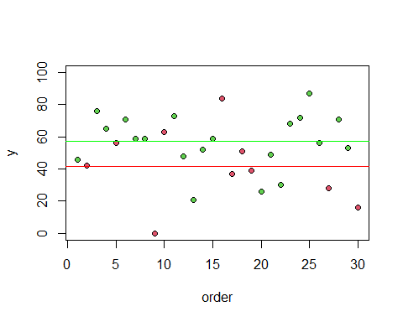
plot(1:30,test.score,ylim=c(0,100),ylab="y",xlab="order", pch=21,bg= as.numeric(as.factor(school))+1 ) abline(h=mean(test.score[school=="good"]),col="green") abline(h=mean(test.score[school=="bad"]), col="red")

Slide 67
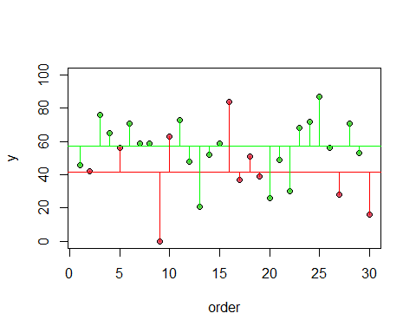

$$SSE=\sum{{\left(y−{\overline{y}}_{1}\right)}^{2}}+\sum{{\left(y−{\overline{y}}_{2}\right)}^{2}}$$
$$SSY=SSG+SSE$$

Slide 68
SSEgood <- sum((test.score[school=="good"]-mean(test.score[school=="good"]))^2) SSEbad <- sum((test.score[school=="bad"]-mean(test.score[school=="bad"]))^2) SSE = SSEgood + SSEbad
SSG = SSY - SSE

